Slide 1




The main theme for this term is ‘Romans‘ This will be taught through History, linking also to some of our writing. We will look at the reasons the Romans came to Britain, the changes they made whilst they were here and learn about life in Roman Britain.
P.E. Days and Kit
Indoor PE will take place on Wednesday and Outdoor PE on Thursday. Children will need to have a PE kit in school for these days. Please ensure your child has a white T-shirt and black shorts, tracksuit bottoms or leggings for these sessions.
Times Tables and CLIC Gaps
In your child’s journal each week, they will write their weekly test scores for CLIC and Beat That. We also encourage all children, whether they are already on the rocket or not, to practise their times tables every week at home. All children have a Times Table Rock Stars login in their journal, and this is a great way to practise.
Reading and Spellings
Please can you make sure your child has their journal in school every day and get them, or yourself, to write in their reads. These will go towards their reading badges each term. They need to do 40 reading to receive their next reading mileage badge.
The weekly spelling lists will be stuck into their journal, ready for their test on a Friday. Please assist them in practising their spellings when you can..

Slide 2







Welcome to Y5 - Autumn – Romans
Physical Development
We will be doing outdoor PE on Wednesday and indoor PE on Thursday.
Our outdoor PE will focus on tag rugby and coordination skills.
Our indoor PE will focus on badminton and dodgeball.
Literacy
We will start the year writing a descriptive piece about the eruption of Mount Vesuvius and the destruction of Pompeii. Exploring and writing about how the Romans changed Britain will form a key part of our writing. We will also create written work based on one of our class novels, There May be a Castle.
Relationships and Health Education
The main focus for this term will be delivered during anti-bullying week. The children will be thinking critically about our digital footprint and how permanent what we post online is and the audience it can reach. This learning builds on communicating with others online and what we should and shouldn’t share about ourselves with strangers.
We will also be considering what makes a close friend, and the feelings involved with friendships and families. They will look at the celebration of marriages in a range of different cultures; as well as the concept of consent.
Understanding the world
In Science, our topic is properties and changes of materials. We will compare materials and their different properties. Then, we will look at the states of solids, liquids and gases, investigating dissolving and how mixtures can be separated.
Maths
The early part of Year 5 will be spent look closely at place value as we move towards using seven-digit numbers (up to a million). After this, we revisit methods of addition and subtraction before moving onto multiplication and fractions. We will also be having a big push on everyone getting on the times table rocket!
Expressive arts and design
In Art, we will be looking at typography and maps. We will learn how to create our own fonts and designs and use visual lettering in different ways to convey emotions. Then, we will combine these skills with map making to produce stunning maps which tell stories.

Slide 3


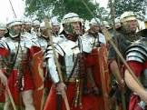
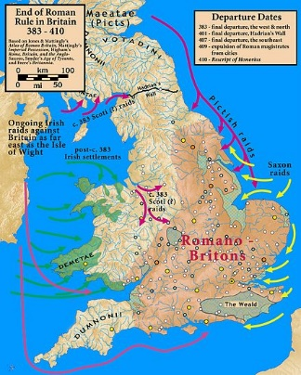
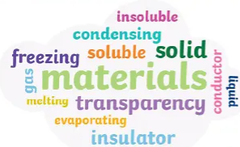
What your child can do to help with their learning
As you will know from Year 4, we have an expectation that each child reads at least four times a week. Regular reading is proven to show a progression in a child’s vocabulary; and their writing also benefits. Enjoy reading with your child: books, magazines, recipes, game instructions, subtitles or newspapers! If you need any reading suggestions or support to help your child read at home, then please speak to us.
Communication and Language
These are some of the key pieces of vocabulary we will encounter during our science topic on properties and changes of materials. Your child could investigate the meanings of these words and make a glossary with the words and the explanations.
Properties, material, soluble, insoluble, dissolve, reversible/irreversible changes, dissolve
Thank you for your support and please send any learning or enquiries to y5@watercliffe.sheffield.sch.uk

Slide 4
Y5 important dates for your diary
Tuesday 1st September- INSET Day 1 (School closed to children)
Wednesday 2nd September - Children back at school
Wednesday 23rd September- Individual photos
Friday 21st October - Flu Vaccinations
Tuesday 6th & Wednesday 7th October - Parents Evenings
Friday 23rd October - Spooky Dress Up Day & Cosy Read
Friday 23rd October - Break up for half-term
Monday 2nd November - Children back at school
Wednesday 25th November - INSET Day 2 (School closed to children)
Tuesday 1st December - Step into Christmas family craft event
Wednesday 2nd December - Christmas Fayre
Wednesday 16th December – Christmas: Dinner, Cosy Read, Singing Outside, and party.
Friday 18th December - Break Up
Monday 4th January - Spring Term starts

