Slide 1

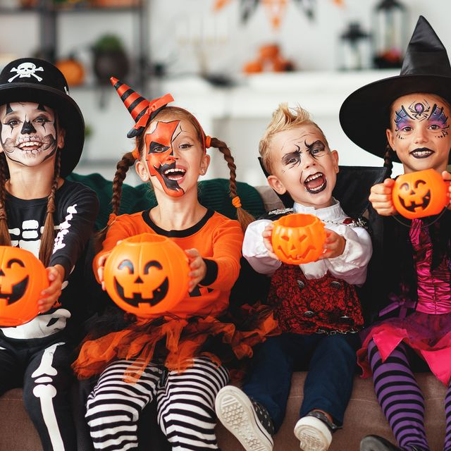
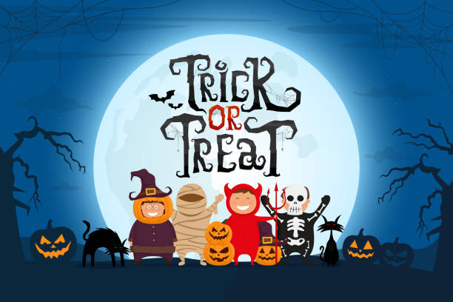

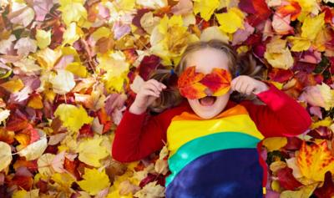
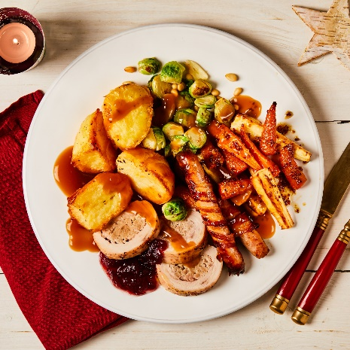
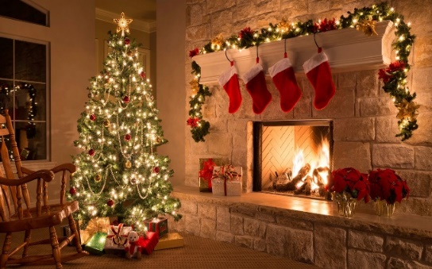
Y3 Important Dates for your diary
Tuesday 1st September- INSET Day 1 (School closed to children)
Wednesday 2nd September - Children back at school
Wednesday 23rd September- Individual photos
Friday 21st October - Flu Vaccinations
Tuesday 6th & Wednesday 7th October - Parents Evenings
Friday 23rd October - Spooky Dress Up Day & Cosy Read
Friday 23rd October - Break up for half-term
Monday 2nd November - Children back at school
Wednesday 25th November - INSET Day 2 (School closed to children)
Tuesday 1st December - Step into Christmas family craft event
Wednesday 2nd December - Christmas Fayre
Wednesday 16th December – Christmas: Dinner, Cosy Read, Singing Outside, and party.
Friday 18th December - Break Up
Monday 4th January - Spring Term starts

Slide 2



The main theme for this term is the ‘Changes in Britain from the Stone Age to the Iron Age’. The children will look at the three stages of the Stone Age, then the Bronze Age and Iron Age, looking at the similarities and differences and how this impacted on Britain, as well has how the conditions in Britain at the time impacted on the life of people.
P.E. Days and Kit
Our PE days are Monday for indoor and outdoor for PE is on Wednesday. Children will need to have a PE kit in school for these days. Please ensure your child has a white T-shirt and black shorts, tracksuit bottoms or leggings for these sessions. It is also essential that your child has suitable shoes for outdoor PE, such as trainers or pumps. All earrings must be removed at home before PE.
Times Tables and CLIC Gaps
In your child’s journal each week will be their weekly test scores for CLIC and Beat That, as well as their CLIC gap. Can you encourage your child to use the CLIC WAGOLL to revise their CLIC gap? Please do not hesitate to come and speak to an adult if we can offer anymore help.
Children spending ten minutes a day learning their target times tables will find their maths a lot easier, and can get their face on the rocket!
Reading and Spellings
Please can you make sure your child has their journal in school every day and get them, or yourself, to write in their reads. These will go towards their reading badges each term. They need to do 40 reading to receive their next reading mileage badge.
The weekly spelling lists will be stuck into their journal, ready for their test on a Friday. Please assist them in practising their spellings when you can.

Slide 3






Welcome to Y3 - Autumn
Changes in Britain from the Stone Age to the Iron Age
Physical Development
We will have two PE sessions each week, one based indoors and one outdoors. These session will build on children’s individual skills, as well as working as a team. They will be taught within mini-tasks and lots of games.
Literacy
The first half term’s reading is all focussed on fluency. Children will be grouped and learn notations and techniques to assist in their reading aloud.
Our writing is centred on basic sentence skills, and will use books linked to our topic.
Understanding the world
Our topic is a history topic. The children will be learning all about the Stone Age, what is means to live pre-civilisation, and what life was like for humans in that period of history. We will learn how clues left behind are how we have learnt so much about these long-ago times!
In science, we are building on a very exciting project surrounding the topic of rocks and soils. In the second half term, through investigations and lessons the children will learn about forces and magnets.
In religious education, we will be studying the religion of Christianity and what it is like to follow God, as well as looking at the ‘Trinity’ and why it is important for Christians.
In addition to this, we look at what we can do to avoid getting ill, as well as looking after our teeth.
Maths
We begin the year with place value, thinking about the value of digits and move on to addition and subtraction. Next half term, addition and subtraction continues and then multiplication and division.
There will be multiple Big Maths sessions each week.
Expressive arts and design
We will use art to learn about the Stone Age and see what they have left behind. Our art unit centres around the use of the medium of charcoal and how this was used by the those in our past.

Slide 4

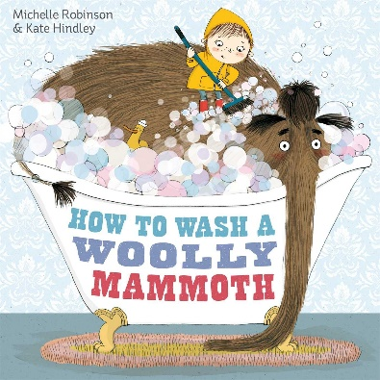
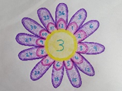

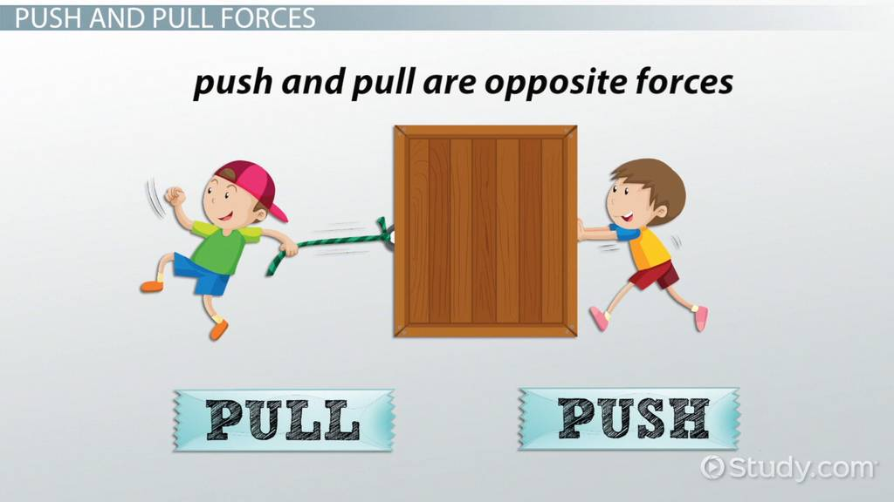
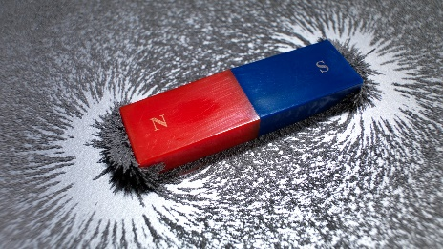
What your child can do to help with their learning
As you will know from last year, we have an expectation that each child reads at least four times a week. Regular reading is proven to show a progression in a child’s vocabulary; and their writing also benefits. Enjoy reading with your child: books, magazines, recipes, game instructions or newspapers!
Communication and language
These are some of the key pieces of vocabulary we will encounter during our science topic. Your child could investigate the meanings of these words and make a glossary with the words and the explanations.
sediment sedimentary rock igneous rock metamorphic rock subsoil fossil
forces magnetic fair test friction push
pull attract repel gravity poles
Thank you for your support and please send any learning or enquiries to y3@watercliffe.sheffield.sch.uk

