Slide 1




Summer Term Key Dates
Monday 13th April - Return to school
Wednesday 15th April - Eid Celebration Day
Monday 4th May - Bank Holiday
Friday 22nd May - Break up Spring Holiday
Monday 1st June - Back to School
Tuesday 9th June - Sports Day AM Y5&6 PM Y3&4
Wednesday 17th June - INSET Day 4
Week Beginning 29th June - "Whose Shoes Shall You Choose" Careers Week
Wednesday 1st July - Class Photos
Tuesday 7th & Wednesday 8th July - Parents' evenings
Friday 10th July - Reports to families
Wednesday 15th July - Carnival
Friday 17th July - Break up for Summer
Monday 20th July - INSET Day 5
Autumn Term 2026
Tuesday 1st September - INSET Day 1
Wednesday 2nd September - Children return to school for Autumn Term
Reading and Spellings
Please can you make sure your child has their journal in school every day and get them, or yourself, to write in their reads. These will go towards their reading badges each term. They need to do 40 reading to receive their next reading mileage badge.
The weekly spelling lists will be stuck into their journal, ready for their test on a Friday. Please assist them in practising their spellings when you can.
P.E. Days and Kit
Swimming, on a Tuesday, for both Y4GH and Y4MB will continue into summer term. Children need to make sure they remember their swimming costume, towel and a healthy snack. Outdoor PE will be on a Thursday afternoon with EVO. Children will need to have a PE kit in school for these days. Please ensure your child has a white T-shirt and black shorts, tracksuit bottoms or leggings for these sessions; as well as suitable footwear.
Times Tables and CLIC Gaps
Weekly CLIC and Beat That test scores and a CLIC gap will be recorded in journals each week. Can you encourage your child to use the CLIC WAGOLL to revise their CLIC gap. Please do not hesitate to come and speak to an adult if we can offer anymore help.
Children spending ten minutes a day learning their times tables will find their maths a lot easier, and can get their face on the rocket! We have our multiplication check this term so children need to make sure they are as prepared as they can be by passing and practising their times tables!

Slide 2
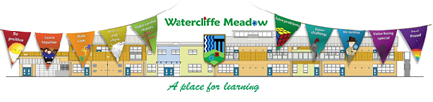


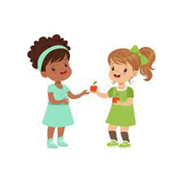



Y4 Summer Term
Literacy
We are beginning a new class book for guided reading, The Legend of Podkin One Ear. In our guided reading sessions, we will enjoy reading and answering questions about the book. In our writing sessions, we will be writing a biography about Sir David Attenborough and a report about animal classification. In summer 2, we will write to persuade and create poetry.
Physical Development
Our outdoor PE sessions are athletics skills: running, jumping, throwing etc. During our indoor sessions we are doing swimming at Hillsborough swimming baths.
Relationships and Health Education
In our weekly circle times and other lessons, one of the things we are exploring is how we show fairness towards other people. We will be looking at how we can help others in the world and make the world a ‘fairer’ place. We will also be looking at how racism can be defined.
Understanding the World
Geography is the main subject for this term, thinking about our local environment and learning lots of skills. Your child will be building on their skills of fieldwork.
In science, through investigations and lessons the children will learn about living things and their habitats, linking to our geography and some of our writing. We will also look at animals, including humans. In this, we look at the human digestive system and our teeth!
Maths
We will be looking at a number of topics including: time, money and properties of shape. We will also have weekly Big Maths sessions covering our CLIC gaps.
Expressive Arts and Design
We will be looking at a number of different artists and understanding their paintings of still images and the impact they have. In D&T, we will look at turning a 2D shape in to a 3D product.

Slide 3
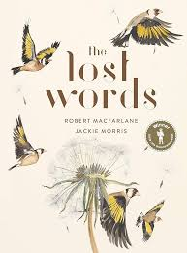
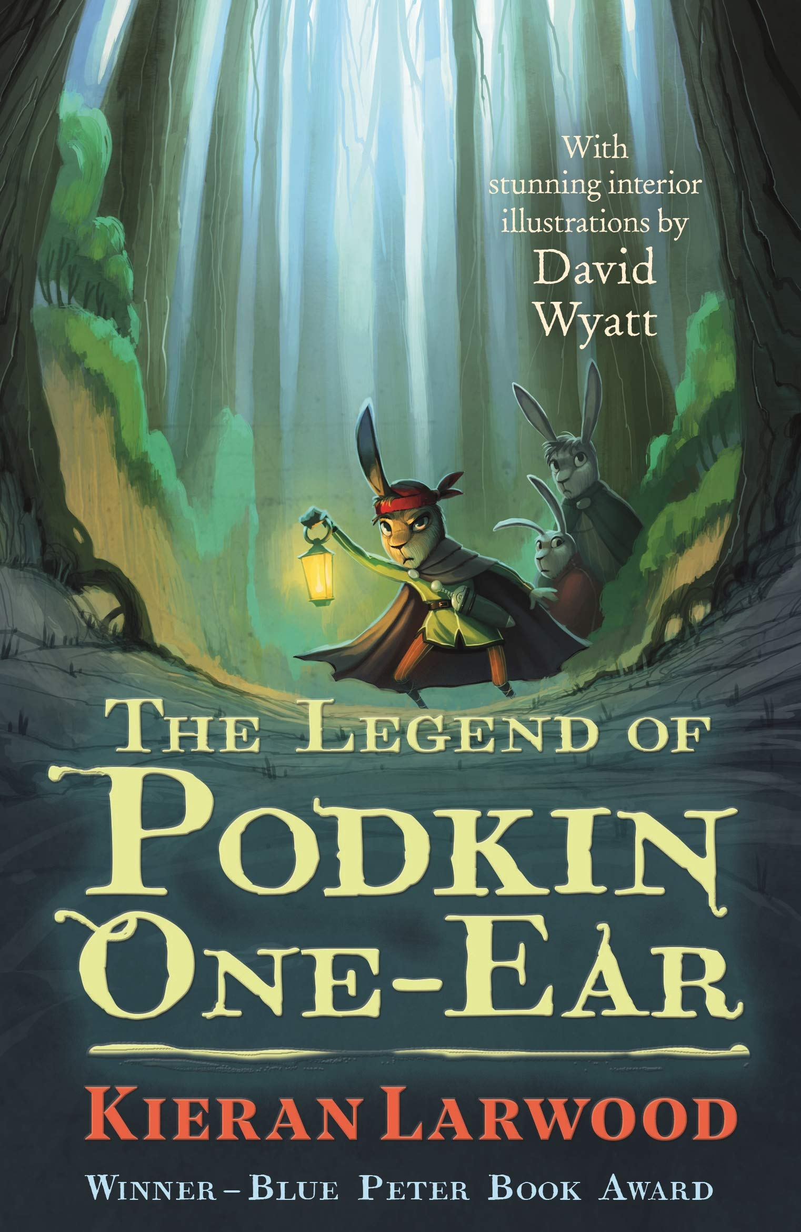

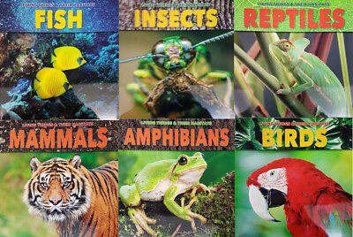

What your child can do to help with their learning
As you will know from last term, we have an expectation that each child reads at least four times a week. Regular reading is proven to show a progression in a child’s vocabulary; and their writing also benefits. Enjoy reading with your child: books, magazines, recipes, game instructions or newspapers!
Your child can use flashcards, dice games, bingo or the familiar website we use in school as a way to practise their times tables. During this term, the children will have a multiplication check (that is a national expectation) in the two-week period from 1st June.
www.timestables.co.uk
Communication and language
These are some of the key pieces of vocabulary we will encounter during our science topic. Your child could investigate the meanings of these words and make a glossary with the words and the explanations.
habitat microhabitat mini-beasts vertebrates invertebrates
mammals birds fish reptiles amphibians
molluscs annelids echinoderms arachnids insects
Thank you for your support and please send any enquiries to y4@watercliffe.sheffield.sch.uk

