Slide 1
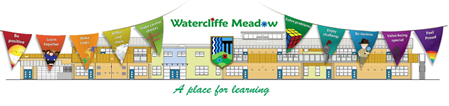


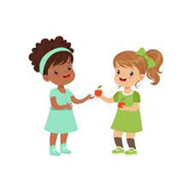



Welcome to F1 - Summer 1 – What you can we find in the garden?
Physical Development
We will be learning a dance to the ‘Ugly Bug Ball’ which we will perform as part of our big finish. We will become more independent at putting our own shoes and coats on. We will be using different one-handed tools and trying to write more letters from our name.
Literacy
In our stories for talking sessions, we will be reading the story ‘The Enormous Turnip’. We will listen to stories and non- fiction books around growing plants and minibeasts. We will be writing labels for different parts of a plant and writing our names on labels for the plants that we will be growing.
Personal, Social and Emotional Development
We will be working together as a class community to help our friends with any problems they might be having and helping to solve conflicts that arise.
We will talk about how we can make our local area better for example by not dropping litter and looking after plants that are growing.
Understanding the world
We will go on a walk around our local area to look for signs of spring and growing. We will also grow our own flowers and vegetables and track their progress.
We will go on a minibeast hunt around our nursery garden to find out which creepy crawlies live there. We will find out first hand about the lifecycle of a caterpillar by looking after our own caterpillars and closely observing what happens to them at each stage of their development. We will learn about farm animals and their babies, what they eat and what their homes are called. Our oldest children will visit Cannon Hall Farm to learn more about farm animals and to see them up close.
Maths
We will be doing lots of problem solving using five frames including making smoothies for the very hungry caterpillar, subitising amounts of fruit and recording how many we need. We will be talking about height using the language ‘taller than’ and ‘shorter than’ me.
Expressive arts and design
We will be taking on the role of customer and shop keeper in our farm shop. We will be carrying out observational drawings and paintings of flowers and plants, carefully choosing which colours to use. We will make 3D models of minibeasts using soft stuff, choosing the correct colour for each part.

Slide 2
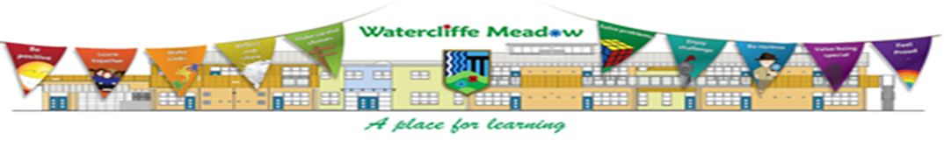
How to help your child this half term
We will be comparing objects by weight and height, you could do this at home finding objects that are heavy and light or objects that are taller than you or shorter than you.
You could find out different information about minibeasts in books or on the computer.
Your child could practise writing their name or other words like mum, dad and sibling names.
Key vocabulary
Some of our key words will be-
Plant, seed, grow, soil, dig, plant pot, watering can, water, roots, petals, stem, leaves.
Egg, caterpillar, chrysalis, butterfly, life cycle, change, grow, bigger.
Stories for talking vocabulary- planting, watering, digging, pulling, eating, man, lady, boy, girl, cat, dog, mouse, seeds, turnip, young/old.
Our selfie home learning this half term will be to spot minibeasts and find signs of spring/ things that are growing. You could also grow things like cress or flowers.
Thank you for your support and please send any photos or enquiries to f1@watercliffe.sheffield.sch.uk

Slide 3
Key Dates for the half term
Monday 13th April- Summer term begins.
Wednesday 15th April- Eid celebration on the bottom MUGA after school at 3:20pm.
Wednesday 22nd April- Cannon Hall Farm visit for N2 children. Nursery closed for N1 children and children who aren’t going on the visit.
Monday 4th May- May Day bank holiday. School closed.
Wednesday 20th May- Ugly Bug Ball big finish.
Friday 22nd May- break up for half term week.

Slide 4

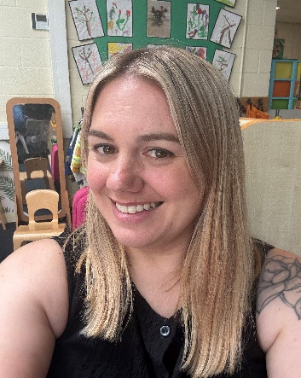
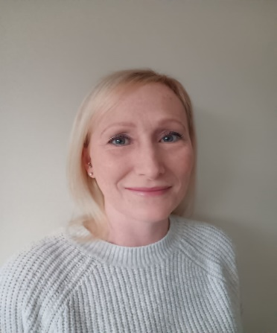

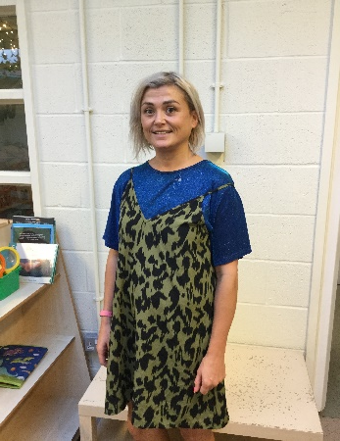
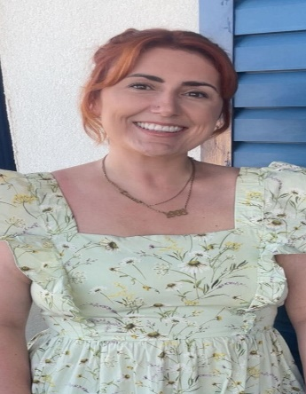
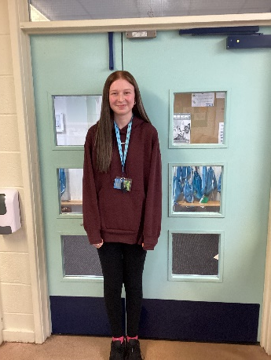
Danielle Houghton
Teacher
Rebecca Moss Teacher
Danielle Page
Teaching Assistant
Lisa Howson
Teaching Assistant
Jen Wilson
Teaching Assistant
Meet the F1 Team
Georgia Dyson
Teaching Assistant
Lauren Gibson
PPA cover

