Slide 1







Welcome to F1 - Spring 2 – Animals at home and in Extreme Environments
Physical Development
We will be manipulating different materials using tools and our hands for example soft stuff. We will be trying really hard to use a knife and fork to cut up our dinner and other objects in nursery.
Literacy
In our stories for talking sessions we will be reading the story ‘Have you got my Purr’. We will be building up our vocabulary around farm, Arctic and Antarctica animals by reading information and story books related to them. We will write lists to use in our farm shop and also write cards, postcards and captions.
Personal, Social and Emotional Development
We will read the book ‘What’s a Penguin to think when he wakes up Pink- It doesn’t matter what you look like’ and talk about how we all have similarities and differences. We will then look in mirrors and compare ourselves to our friends talking about what is the same and what is different.
We will be playing in groups to act out role-play situations, listening to each other and sharing resources.
We will be developing our sustained shared thinking skills which is where we work together as a pair to solve a problem.
Understanding the world
We will be exploring ice and finding out how to make it and what happens when it is left in the classroom. We will receive a visit from a couple of special animals which we will need to look after by finding out information on the internet and from books. We will learn about the North and South Pole and the animals that live there.
We will learn about farm animals and their babies, what they eat and what their homes are called.
We will compare what the Arctic looks like compared to England and decide if the weather is the same or if the animals that live in England could live in the Arctic or Antarctica.
Maths
We will be sorting, subitising, counting and recording amounts of farm animals. We will be looking at the composition of numbers up to 5 e.g. that 4 can be made with a 2 and a 2, a 3 and a 1 or a 1,1,1 and a 1.
We will solve problems involving numbers to 5 using our subitising skills.
Expressive arts and design
We will be taking on the role of customer and shop keeper in our farm shop. We will make 3D penguins using soft stuff and tractors using junk modelling. We will act out being Arctic explorers in our role-play area.

Slide 2

How to help your child this half term
If you have any stories related to our topic of farms, Arctic or Antarctica you are welcome to bring them in for us to read to the children.
Talk to your children about the animals that live on a farm, name them and talk about the noises they make.
We will have a selfie home learning around creating an Easter bonnet for our Easter bonnet parade.
Key vocabulary
Some of our key words will be-
Stories for talking vocabulary- Cow, horse, pig, sheep, goat, duck, cat, dog, mouse, owl. Verbs- Walk, swim, cry, swim, sleep, happy, sad.
Animal babies- calf, foal, piglet, kitten, puppy, lamb, hen, chick
Farm, barn, field, pond, sty, tractor
South Pole, Antarctica, penguins.
North Pole, Arctic, polar bears
Weather- snow, ice, freezing, cold
Thank you for your support and please send any photos or enquiries to f1@watercliffe.sheffield.sch.uk

Slide 3
Key Dates for the half term
Monday 23rd February- Spring 2 half term starts.
Wednesday 25th February- nursery workshop- Time for Bed.
Wednesday 4th March- Final nursery workshop- We are Family
Wednesday 4th March- World Book Day- come dressed up as a book character of your choice.
Friday 20th March- Red nose day.
Wednesday 25th March- Easter bonnet parade AM and PM.
Friday 27th March- Finish for Easter.

Slide 4

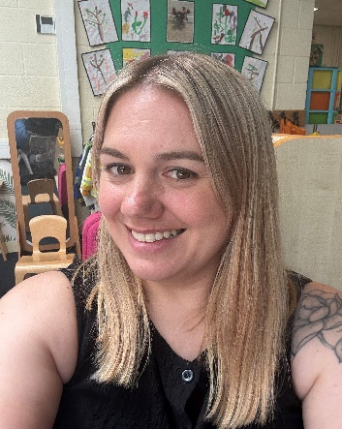
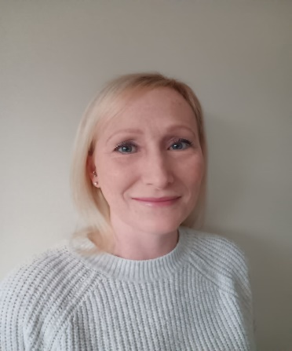

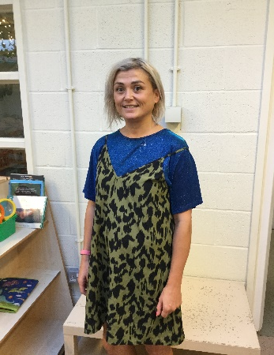
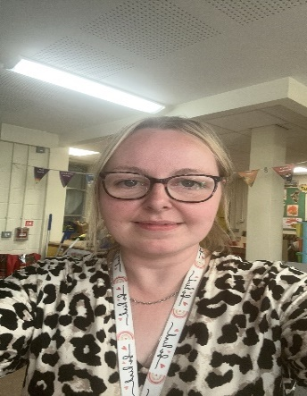
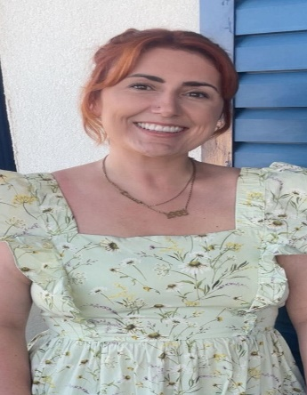
Danielle Houghton
Teacher
Rebecca Moss Teacher
Danielle Page
Teaching Assistant
Lisa Howson
Teaching Assistant
Jen Wilson
Teaching Assistant
Meet the F1 Team
Toni Mortimer
Teaching Assistant
Lauren Gibson
PPA cover

