Slide 1







Welcome to F1 - Spring 1 – Where will our journey end?
Physical Development
In the provision we will continue to develop our pincer grip on the finger gym by threading, tracing and using brushes to excavate dinosaur skeletons. In our EVO PE sessions, we will be learning new games building on our skills that we have developed in previous half terms. PE days are Tuesday AM and Thursday PM- no earrings to be worn.
Literacy
In our stories for talking sessions, we will be reading the story ‘Walking through the Jungle’. We will be answering why and how questions and building up our vocabulary around African animals and dinosaurs by reading information and story books related. As we role-play as explorers, we will write about what we find in our dinosaur dig and jungle area.
Personal, Social and Emotional Development
In our P4C sessions we will be doing ‘big thinking’ to answer questions such as ‘If a dinosaur could talk what would you ask it?’ and ‘Would you rather be a lion or a monkey, why?’ We will continue to develop our circle time skills in particular using our speaking skills to solve problems and share our ideas.
We will welcome some new children into nursery and will find out all about them. We will help them to settle in, form friendships with them and help them to play in the provision.
Understanding the world
We will look for signs of Winter around our school grounds, talking about what happens to the trees and what the weather is like compared to when we went on our Autumn walk.
We will be learning about dinosaurs and African animals. We will find out interesting facts and information. We will become explorers and learn how to excavate dinosaur bones. We will find out how dinosaurs used to be alive but are now extinct. We will compare Africa to England and talk about if the weather is the same and if the animals that live there are the same or different.
Maths
We will use language such as ‘long’, ‘tall’, ‘short’ and ‘flat’ to describe different animals from the story ‘Dear Zoo’. We will sing number songs like 5 little monkeys and use our knowledge of five frames to work out how many are left when 1 is taken away.
Expressive arts and design
We will be learning some new animal and dinosaur songs. We will collage dinosaur skeletons using pasta or art straws. We will design and build homes for different jungle animals thinking carefully about their sizes and the shape of the bricks.

Slide 2

How to help your child this half term
This half term we will be walking around our school grounds looking for signs of winter, if you are out and about and spot any signs of winter for example no leaves on the trees, snow or ice, send us a selfie to put on the blog this will be an excellent start to your children’s learning.
Last half term we did lots of comparing amounts, so you could compare amounts with your child for example talk about who has the most juice, who has the fewest sweets and can they make it so you both have the same amount.
If you have any stories related to our topics you are welcome to bring them in for us to read to the children.
Key vocabulary
Some of our key words will be-
Stories for talking- walking, crawling, jumping, splashing, running, lion, giraffe, crocodile, zebra, snake, elephant, monkey, crocodile, hippo noisy, quiet
Mathematical language- big, little, small, tall, long, short, heavy, light, shapes names, round, circle, square, rectangle, pointy, triangle, straight, curved.
Descriptive/ pattern language e.g. stripy, spotty, spiky, rough, scaly, smooth.
Cold, freezing, snow, ice, wind, rain, cloudy, foggy, hot, sun
Dinosaur names- Triceratops, tyrannosaurus rex, stegosaurus, brachiosaurus
extinct, fossil, palaeontologist.
Thank you for your support and please send any photos or enquiries to f1@watercliffe.sheffield.sch.uk

Slide 3
Key Dates for the half term
Monday 5th January- Back to school.
Wednesday 14th January- Animal handling Workshop for children in school.
Wednesday 21st January- Food for thought Workshop.
Tuesday 27th and Wednesday 28th January- Parent’s Evenings Tuesday 3:30-5:00pm and Wednesday 3:30-7:00pm.
Wednesday 28th January- It’s good to talk Workshop.
Wednesday 4th February- Out to play Workshop.
Wednesday 11th February- Mind, Movement and Milestones Workshop.
Friday 13th February- Finish for half term.

Slide 4

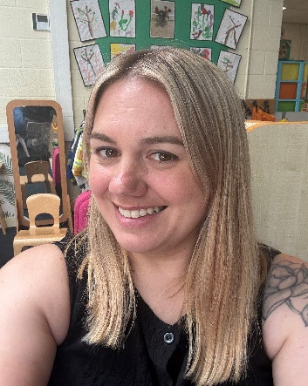
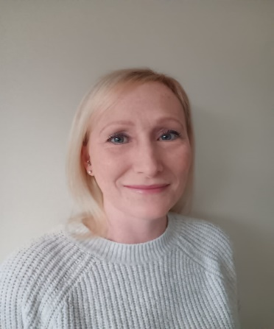

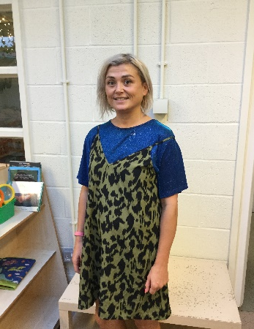
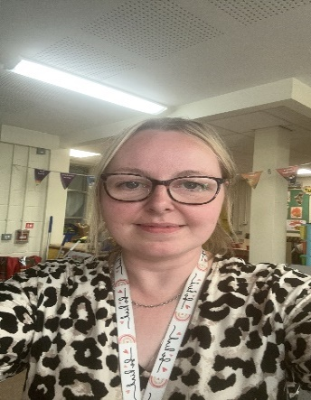
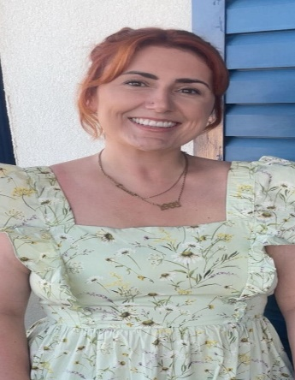
Danielle Houghton
Teacher
Rebecca Moss Teacher
Danielle Page
Teaching Assistant
Lisa Howson
Teaching Assistant
Jen Wilson
Teaching Assistant
Meet the F1 Team
Toni Mortimer
Teaching Assistant
Lauren Gibson
PPA cover

