Slide 1
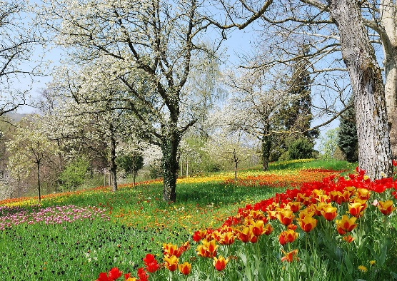



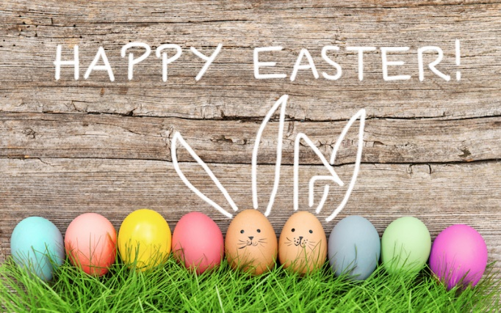
Y4 Important Spring Dates for your diary
Monday 5th January – Spring term begins
Wednesday 14th January - Y4 Visiting 2026 ISU European Figure Skating Championships
Tuesday 27th & Wednesday 28th January - Parents' Evening
Wednesday 11th February – Young Voices (Sheffield Arena)
Friday 13th February – WCMGT Final
Friday 13th February - Finish for half term
Monday 16th - Friday 20th February - Half Term Holiday
Monday 23rd February - Spring 2 starts
Wednesday 4th March - World Book Day @ WCM (Cosy Read & dressing-up)
Wednesday 11th March – INSET 4/5 school closed for children
Monday 16th & Tuesday 17th March - D&T Exhibition in the hall
Friday 20th March – Red Nose Day (Dressing-Up)
- Y4 Little Bikers (in school)
Week Beginning 23rd March - Easter Events (Egg Challenge Competition)
Y4 Thornbridge Residential (Mon – Wed or Wed – Fri)
Friday 27th March - Finish for Easter Holidays
Monday 30th March – Friday 10th April – Easter Holidays
Monday 13th April - Summer 1 starts
Wednesday 15th April – Eid Celebration (3:20-4:00pm)

Slide 2



The main theme for this term is Volcanoes and Earthquakes. This is a geography topic.
P.E. Days and Kit
Indoor PE is still on a Wednesday. Outdoor PE is on a Thursday. Children will need to have a PE kit in school for these days. Please ensure your child has a white T-shirt and black shorts, tracksuit bottoms or leggings for these sessions. Now the weather is colder, a jumper for outdoors will be useful. It is also essential that your child has suitable shoes for outdoor PE, such as trainers or pumps. All earrings must be removed at home before PE.
Reading and Spellings
Please continue to encourage your child to read, 4 or more a week, and write these in their journal. These will go towards their reading badges each term. They need to do 40 reads to receive their next reading mileage badge. We had some people receiving their badges before Christmas, so would love even more this term!
The weekly spelling lists will be stuck into their journal, ready for their test on a Friday. Please assist them in practising their spellings when you can.
Times Tables and CLIC Gaps
In your child’s journal each week will be their weekly test scores for CLIC and Beat That, as well as their CLIC gap. Can you encourage your child to use the CLIC WAGOLL to revise their CLIC gap? Please do not hesitate to come and speak to an adult if we can offer anymore help.
Children spending ten minutes a day learning their target times tables will find their maths a lot easier, and can get their face on the rocket! We are having some great successes. The national times table test will be at the end of this term.

Slide 3







Y4 Spring
Volcanoes and Earthquakes
Physical Development
Our outdoor sessions will continue to be a varied set of sessions with EVO. Indoor sessions will start off gymnastics and then switch to swimming for the rest of the year. We will let you know more details nearer the time.
Literacy
We are doing some writing about some amazing books or films this term – A Viking Adventure, Feast and Lift. We will also be writing a non-chronological report about habitats. We have two new books for guided reading this term, too!
RSHE
Building on all our previous RSHE lessons, the year four spring learning is around how we treat those around us. We will reflect on the differences and similarities between boys and girls and the assumptions that can be made here and how we can fight stereotypes.
Understanding the World
Our topic this term is a geography topic about volcanoes and earthquakes. Alongside looking at atlases, the globe and other maps so we can learn more about the physical geography of the world, we are also going to learn more about volcanoes and earthquakes. This involves how they happen, where they are found and what effect they can have.
In science, children will learn to identify that a circuit needs to be a complete loop with a cell and that some materials conduct electricity.
Maths
The first block of learning we have for this term is a unit on length and perimeter. This builds on our understanding of measure and shape. Later on we are doing a unit fractions and decimals.
Expressive Arts and Design
We will continue our clarinet sessions until early February. Our design and technology unit later in the term is around designing and making torches.

Slide 4
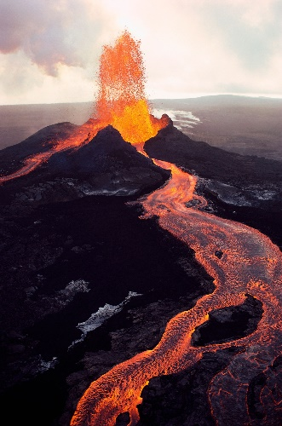
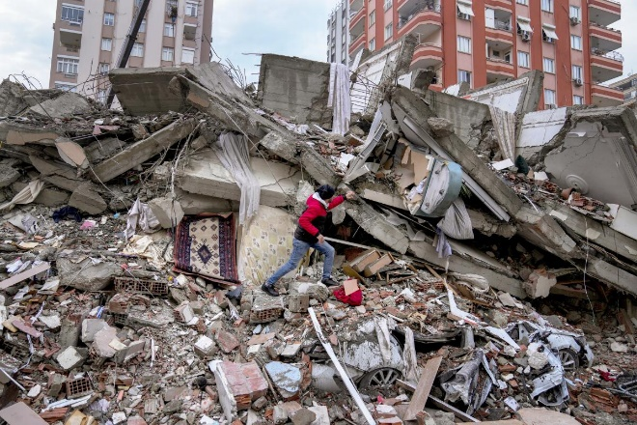
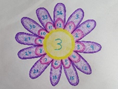

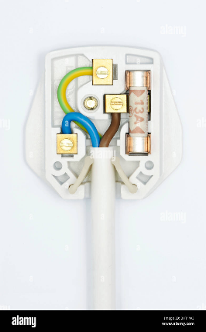
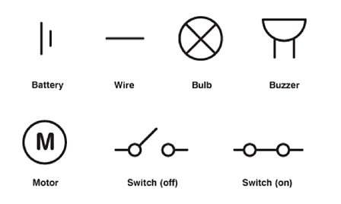
What your child can do to help with their learning
After a term in Y4, you will know that we have an expectation that each child reads at least four times a week. As we have mentioned before, regular reading is proven to show a progression in a child’s vocabulary; and their writing also benefits. Enjoy reading with your child: books, magazines, recipes, game instructions or newspapers all count.
Your child can use timestables.co.uk as a way to practise their times tables, as well as the other methods, such as bingo or dice games. We will be incorporating times tables into weekly lessons too, as a boost! Please remember that children will take the National Times Table test at the end of this term.
Communication and Language
These are some of the key pieces of vocabulary we will encounter during our science topic. Your child could investigate the meanings of these words and make a glossary with the words and the explanations.
electricity, circuit, battery, bulb, motor, buzzer, wire,
crocodile clips, switch, conductor, insulator
Thank you for your support and please send any learning or enquiries to y4@watercliffe.sheffield.sch.uk

