Slide 1







Welcome to F1 - Autumn 2- Let’s Imagine!
Physical Development
In our EVO PE sessions we will be continuing to play different games to develop our physical skills such as walking on tiptoes, lunging, squatting, moving in different ways, balancing on one foot and also listening carefully to instructions. In nursery provision we will be developing our skill of using scissors carefully and effectively to cut different materials.
Literacy
In our stories for talking sessions we will be reading the story ‘Goldilocks and the Three Bears’. We will write captions, invitations and letters. We will read books related to different fairy tales and also ones with a twist. We will make up our own fairy tales using picture cards of characters, objects and settings.
Personal, Social and Emotional Development
In our circle times we will use our understanding of the Zones of Regulation to help our puppet animals solve problems around their feelings. We will decide whether they are feeling blue (sad), green (happy), yellow (wobbly) or red (angry) zone and what strategies we can use to help them while they are in that zone. We will continue to work on our sharing and turn taking skills, realising that we can’t always have the toy we want straight away and might have to wait.
Understanding the world
Maths
In our Little Big Maths sessions we will again continue to develop our subitising skills first to 3 and then move onto 4 and 5. We will be comparing amounts deciding who has the most and fewest. We will introduce the words long, tall and short. In the water tray we will explore capacity.
We will continue to learn about similarities and differences between ourselves and others by learning about the Christmas story and the celebration of Christmas. We will compare Christmas to the celebration of Eid and talk about what is the same and what is different.
Expressive arts and design
We will learn different fairy tale songs which we will perform to our parents. We will be using small world characters to act out different fairy tales e.g. Goldilocks and the Three Bears. We will be dressing up as fairy tale characters to act out stories.

Slide 2

How to help your child this half term
If you have any fairy tales or stories related to witches, dragons and fairies please feel free to bring them into nursery for us to read and also share them with your child at home.
Practise subitising with your child- quickly spotting different groups of amounts without counting them. Start with noticing 1 and 2 objects e.g. 2 socks, 1 teddy, 2 cars, 1 ball. When your children are able to subitise 1 and 2 quickly you can move onto subitising 3 objects.
Key vocabulary
Some of our key words will be-
Dragon, Princess, Prince, Witch, Wizard, Fairy, Giant
Castle, Forest, Tower, Cottage
Sword, Wand, Jewels
Goldilocks, bears, pigs, gingerbread man, goats, Jack.
Stories for talking vocabulary- bowl, spoon, porridge, chair, bed, fork, knife, plate, table, cup, walking, sleeping, sitting, running, eating, big and little.
Our selfie home learning this half term will be for you to send us a photo of your child dressed as a fairy tale character or superhero and tell us why your child likes that character so much.
Thank you for your support and please send any photos or enquiries to f1@watercliffe.sheffield.sch.uk

Slide 3
Key Dates for the half term
Monday 3rd November- Children back at School after half term.
Wednesday 19th November- Sundown Adventureland Visit. Nursery closed for children not going on the visit.
Wednesday 26th November- Training Day 3- School closed to all children.
Wednesday 3rd December- Christmas Fayre- children can be picked up from 2pm and Step into Christmas workshops in nursery- 9:00am and 12:20pm.
Week beginning 8th December- Nativity Plays.
Week beginning 15th December- Christmas jumper week.
Wednesday 17th December- Christmas dinner day and Nursery Christmas party day.
Friday 19th December- Break up for holiday.

Slide 4

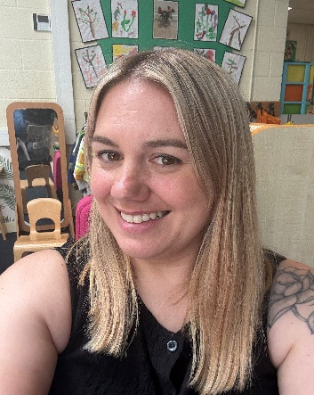
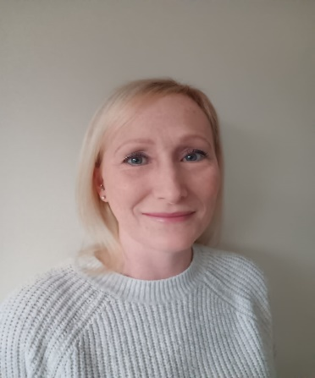

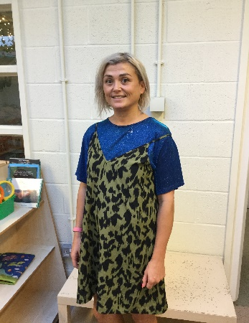
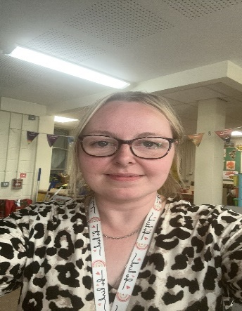
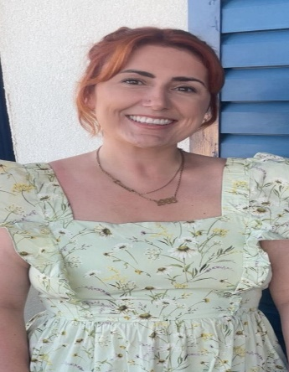
Danielle Houghton
Teacher
Rebecca Moss Teacher
Danielle Page
Teaching Assistant
Lisa Howson
Teaching Assistant
Jen Wilson
Teaching Assistant
Meet the F1 Team
Toni Mortimer
Teaching Assistant
Lauren Gibson
PPA cover

