Slide 1




The main theme for this term is “Changes in Living Memory!”
This will be taught through science, RSHE and art, linking also to some of our writing.
We will go on a visit to Eureka to support our learning all about ourselves and how we use our senses.
P.E. Days and Kit
For the next term, our outdoor PE sessions are on Tuesday with our sports coach. Our indoor PE sessions will be on Monday. Children will need to have a PE kit in school for these days. Please ensure your child has a white T-shirt and black shorts, tracksuit bottoms or leggings for these sessions and suitable shoes for outdoor PE.
Number bonds
We will be practicing our number bonds to 10 a lot in the first term. Knowing our number bonds and being able to recall them quickly helps enormously with all maths learning.
Please talk to us if you need any support with helping your child practice number bonds at home.
Reading and Spellings
Please can you make sure your child has their reading journal in school every day and record any reads they do at home. They need to do 40 reads to receive their reading mileage badges.
Your child will be sent home with a Read, Write, Inc. book as well as a sharing book to read at home.

Slide 2







Communication, language and literacy
We will be talking about ourselves and our families and listening to stories around this theme. We will be writing descriptions of our families and labelling different body parts. We will also be looking at adjectives and linking these to our 5 senses. In our RWI sessions, we will be learning new ways to read and write sounds. We will then practise using our phonics to write simple sentences. We will be concentrating on checking our writing to make sure it makes sense. We will carry on learning new sounds to help us with our reading and writing.
Welcome to Y1 – Autumn Term – Changes in living memory
Maths
We will be looking at numbers to 20, counting, partitioning and ordering them; as well as looking at number bonds to 10. We will also compare sets of objects. We will be learning addition and subtraction methods.
We will be encouraging children to count forwards and backwards to 10 to begin with.
In Big Maths we are continuing our counting skills and to count in 10s. We will begin doing our CLIC tests every Friday and seeing if we can beat our own scores.
Relationships and Health Education
In the autumn term, we will be talking about our families, who is in them and what the roles are of those in it. As a part of this we will look at how as a family we make each other happy.
In addition to this the children will think about what a friend is, and the difference between them, a family member, a stranger and an acquaintance.
To start the year off we will be concentrating on our Golden Rules and helping everyone to be kind and helpful in and around school. We will be talking about what the expectations are in our classrooms and creating our own ‘Class Charter’. We will focus on the Golden Rules during our class circle times. Also we will be talking about things that make us feel happy and safe in school and at home.
If you have any questions about the learning outlined, then please talk to us.
Physical Development
Our indoor PE session is on Monday and our outdoor PE session is on Tuesday.
We will be using our outdoor environment to develop our physical skills and co-ordination.
We will be learning about different ways to travel, balances and our team working skills.
.
Expressive arts and design
We are learning that drawing is a physical and emotional activity. That when we draw, we can move our whole body. That we can control the lines we make by being aware of how we hold a drawing tool, how much pressure we apply, and how fast or slow we move. That we can draw from observation or imagination. That we can use colour to help our drawings engage others.
Understanding the world
We will be learning about different religions and cultures that people believe in and investigating how people celebrate.
We will be using our senses to investigate the world around us; during our visit to Eureka in October we will be taking part in a special workshop all about our senses. In history we will be thinking about events that have happened in living memory.

Slide 3


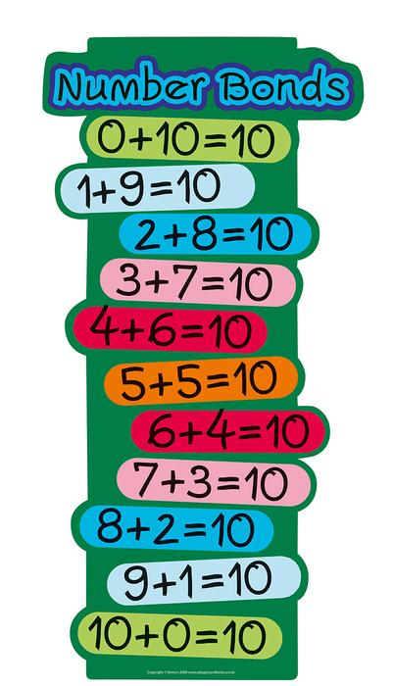


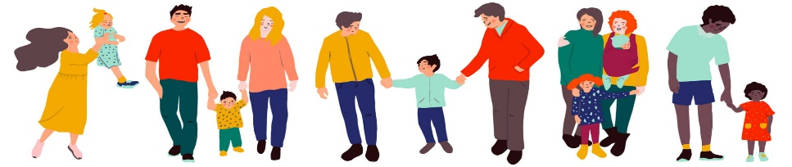
Dates for your diary
Monday 1st & Tuesday 2nd September– Training day 1 & 2 School closed to children
Tuesday 9th September – Parents phonics meeting
Wednesday 24th September – Individual photos
Tuesday 7th October – Parents Evening 3.30-5pm
Wednesday 8th October – Parents Evening 3.30-7.00pm
Wednesday 22nd October – Eureka visit
Friday 24th October – Halloween Cosy Read
Friday 24th October - Break up
Monday 3rd November - Children back at school
Wednesday 26th November - Training Day 2 School closed to children
Monday 1st December – Step into Christmas
Wednesday 3rd December – Christmas Fayre
Week Beginning 8th December - Nativity Play F1, F2 & Y1
Wednesday 17th December - Christmas Dinner & Cosy Read
Friday 19th December - Break Up
Monday 5th January - Spring Term starts
Thank you for your support and please send any learning or enquiries to y1@watercliffe.sheffield.sch.uk

