Slide 1







Welcome to F1 - Autumn 1 – We are Family!
Physical Development
In our PE sessions we will develop our fundamental movement skills through the topic of 'all about me'. Fundamental skills will include balancing, running, changing direction, jumping, hopping and travelling. We will be finding out which is our dominant hand for holding a pencil and be making marks such as lines and circles or even letters from our name.
Literacy
In our stories for talking sessions we will be reading the story ‘The Washing Line’ and carrying out different activities related to the story based at a 1, 2 or 3 key word level. We will begin our mark making by drawing a picture of ourselves and attempting to write our name.
Personal, Social and Emotional Development
We will welcome our new children into nursery and help them to settle in, make friends and have lots of fun!
We will explore our emotions using the book ‘The Colour Monster’
In our circle times we will find out about our new children, what they like to play with, who is in their family, their favourite food, TV shows and things they do at home.
We will find out about the celebration of Eid and compare it to the celebration of Christmas, talking about any similarities and differences.
Understanding the world
We will begin the half term by talking about the adventures we had over the summer holidays with our families.
We will read stories about different families and talk about our families and how they are the same or different in terms of family members. We will compare ourselves to our friends looking at our hair, eyes, skin colour and other features deciding whether we are the same and different.
Maths
In our Little Big Maths sessions, we will be subitising (this is fast recognition of objects without counting) up to 5 objects. We will learn ‘enough’, ‘bigger’ and ‘smaller’. In the construction area we will build houses, shops and other recognisable landmarks from our local area.
Expressive arts and design
We will paint, collage, draw and create our faces using loose parts. We will learn different songs related to ourselves.

Slide 2

How to help your child this half term
Point out print in the environment for example bus stop sign, stop sign and supermarket names to help your child with early reading skills.
Practise subitising with your child- quickly spotting different groups of amounts without counting them. Start with noticing 1 and 2 objects e.g. 2 socks, 1 teddy, 2 cars, 1 ball. When your children are able to subitise 1 and 2 quickly you can move onto subitising 3 objects.
Key vocabulary
Some of our key words will be-
Growing, older, taller, bigger, baby, crawl, milk, bottle.
Family member names
Same/ different
Body parts, face features and skin tones to describe similarities and differences.
Positional words- in, on, under, next to, behind, in front.
Map, route, road, roundabout, up, down, corner, turn.
Stories for talking vocabulary- socks, dress, pants, jumper, scarf, trousers, coat, t-shirt, hat, shorts, wet, dry, wearing, washing, drying, hanging, splashing.
Our selfie home learning this half term will be for you to send us a photo of your child finding different shop logos or familiar buildings from our local area of Shirecliffe.
Thank you for your support and please send any photos or enquiries to f1@watercliffe.sheffield.sch.uk

Slide 3
Key Dates for the half term
Monday 1st September and Tuesday 2nd September- Training Day 1 and 2. School closed to children.
Wednesday 3rd September- Stay and Play sessions for new starters to meet teachers- 9-11am and 1-3pm.
Thursday 4th September- Children start back at nursery.
Wednesday 24th September- Individual photos.
Tuesday 7th and Wednesday 8th October- Parents Evenings.
Wednesday 22nd October- Spooky dress up day.
Friday 24th October- Break up for Half Term.

Slide 4

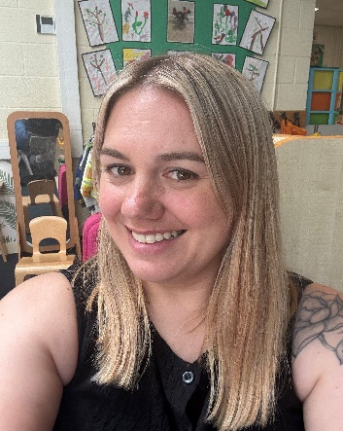
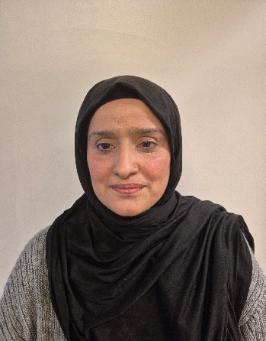
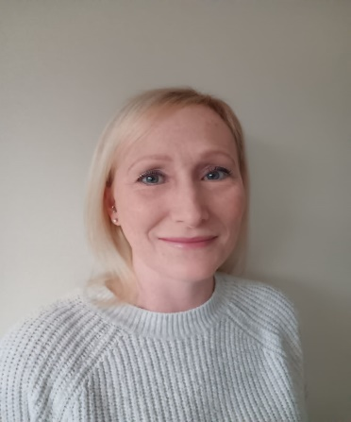

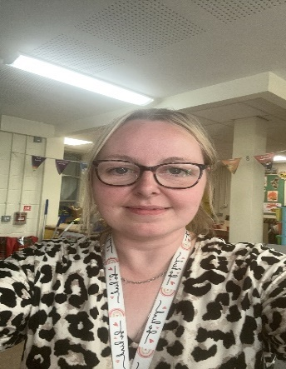
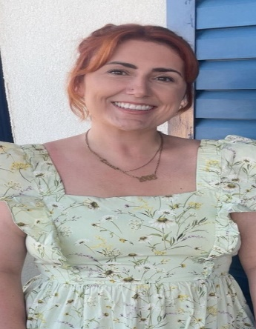
Danielle Houghton
Teacher
Rebecca Moss Teacher
Shazia Tanveer
Teaching Assistant
Lisa Howson
Teaching Assistant
Jen Wilson
Teaching Assistant
Meet the F1 Team
Toni Mortimer
Teaching Assistant
Lauren Gibson
PPA cover

