Slide 1







Welcome to F1 - Summer 2 – Were all going on a Summer Holiday!
Physical Development
We will be discussing which foods are healthy, how to look after our teeth, why we should exercise and the importance of getting lots of sleep. We will learn a Summer holiday dance which we will perform at our big finish.
Literacy
In our stories for talking sessions we will be reading the story ‘We all go Travelling by’. We will read fiction and non- fiction books linked to our themes of pirates, under the sea, transport and holidays. We will be writing lists of items to take on holiday and postcards from places we have visited.
Personal, Social and Emotional Development
In our P4C sessions we will be doing ‘big thinking’ to answer questions such as ‘should we eat chocolate and sweets for every meal?”
When we play in the provision we will be engaging in sustained shared thinking this means we will work together in a small group or pair to solve problems or extend a storyline, we will listen to each other and respond appropriately.
Understanding the world
We will talk about our past experiences we have had with our families for example holidays we have been on, what country we went to, who we went with and what we did while we were there. We will again go for a walk around our school grounds comparing what the trees and plants look like in Summer compared to when we went in Autumn, Winter and Spring. Our oldest nursery children will get to experience a visit to the seaside where they will enjoy time on the beach, chip shop dinner, a donkey ride and an ice cream. We will compare what the seaside looks like compared to Shirecliffe.
Maths
We will be ordering items by length using the words ‘longer than’ and ‘ shorter than’. We will be practising 1-1 counting different amounts and recalling what the total amount was. We will continue to name 2D shapes and say how many sides and corners they have.
Expressive arts and design
We will be learning some seaside songs to perform for our big finish. We will use materials on our creative workshop to create 3D transport such as a train. We will take on different roles with our friends in our beach, ice cream shop, camping and train station role play areas, communicating in role.

Slide 2

How to help your child this half term
Talk to your child about any holidays they have been on, where they went to, who with, how they travelled there and what they did. You could send photos into nursery to help your child to talk about their holiday.
You could write holiday lists together at home with your child helping you to hear the initial sound at the start of each word.
You could find long and short objects around your home and use the words ‘longer than’ and ‘shorter than’ to compare them. You could also practice 1-1 counting of objects saying a number name as you touch an object.
Key vocabulary
Some of our key words will be-
Stories for Talking vocabulary- plane, train, bus, car, lorry, boat, bike, motorbike, fly, sail, ride, drive, fast, slow
Lobster, octopus, sting ray, whale, swordfish, snorkel, dive, coral
Treasure, map, compass, gangplank, telescope, parrot, island
Suitcase, sun cream, travel, passport, ticket, abroad, packing, hotel, caravan, tent, camping, donkey, bucket, spade, sandcastle
Our selfie home learning this half term will be to have a transport selfie this could be on a plane, train, bus or car etc.
Thank you for your support and please send any photos or enquiries to f1@watercliffe.sheffield.sch.uk

Slide 3
Key Dates for the half term
Monday 2nd June- Back to school.
Wednesday 11th June AM- Sports Day for all nursery children. Nursery closed in the afternoon.
Wednesday 18th June- Class Photos.
Wednesday 25th June- Cleethorpes visit for older children. Nursery closed for younger children and children not going on the visit.
Thursday 3rd July and Friday 4th July- Inset days. Schools closed for all children.
Wednesday 9th July- Nursery Seaside Day. See letter with details nearer the time.
Wednesday 9th July after school- drop in for families to talk to key workers about progress.
Wednesday 16th July- Carnival.
Wednesday 23rd July- Break up for Summer holidays.

Slide 4
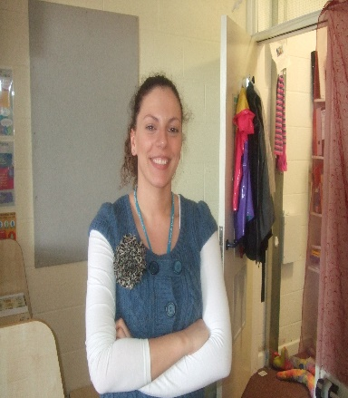

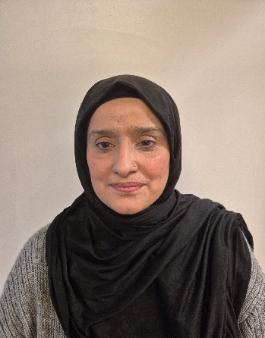
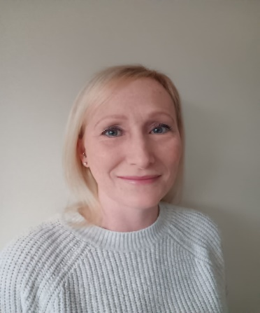
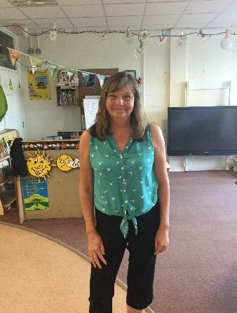

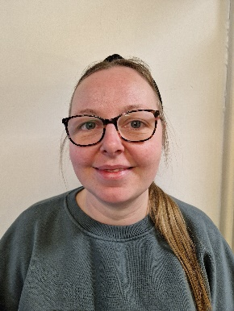
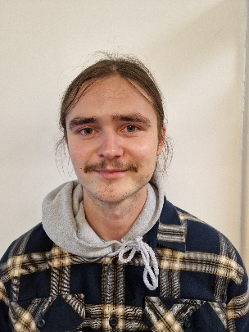
Danielle Houghton
Teacher
Jodie Moxam HLTA
Shazia Tanveer
Teaching Assistant
Diane Fenton
Teaching Assistant
Lisa Howson
Teaching Assistant
Jen Wilson
Teaching Assistant
Meet the F1 Team
Toni Mortimer
Teaching Assistant
Felix Donnison
Teaching Assistant

