Slide 1




The main theme for this term is Geography linked to ‘The Journey’ by Neil Griffiths. We will learn to name, locate and identify characteristics in the United Kingdom. We will be exploring locations of human and physical features on a map.
We will be learning about flowers, plants and trees in Science as well as observing seasonal changes as we head into Summer. We are also going to be exploring watercolours and learning about artists and how to colour mix and create our own paintings.
P.E. Days and Kit
Both classes have PE on Tuesdays and Wednesdays in Summer 1. In Summer 2, we will be doing dance on Mondays so our PE days will change to Monday and Tuesday.
Please ensure that your child has the correct PE kit that is a plain white t-shirt, black or grey shorts/joggers and trainers for outdoor PE. Bring your uniform with you and we will get changed in class after P.E.
Counting in 2s, 5s and 10s
To help your child get on the rocket and prepare them for year 2 can you help them count in 2s, 5s and 10s. We are linking this to the times tables and counting to 10 times each number.
If children that are already on the rocket can keep practicing recalling double, half and number bond facts quickly that will really help them with their maths.
Reading and Phonics
Please can you make sure your child has their journal in school every day and get them, or yourself, to write in their reads. These will go towards their reading badges each term. They need to do 40 reads to receive their next reading mileage badge. It would be wonderful to have even more children get their badges this term.
Your child will be sent home with a Read, Write, Inc. book as well as sharing books to read at home.

Slide 2







Welcome to Y1 - Summer Term
Journeys
Literacy
This term we will be continuing our Read, Write Inc. groups to learn our literacy skills. We will read and write familiar fairy tales. We will be retelling stories using puppets, sequencing events and writing about characters and settings. We are excited to launch our storytelling topic with a visit to Bolsover Castle!
All Y1 pupils will receive daily Read, Write Inc. sessions at their level.
Physical Development
We will be continuing the great work we have been doing with the Evo sports coaches on basic skills and team games. They have been really impressed with the progress the children have made so far this year! Our other PE units are dance and athletics, as we prepare for sports day.
Relationships and Health Education
In the summer term, we will be thinking all about how we can help ourselves to be happy. These ideas will be explored through circle time and children will think about what they would like to pack in a happiness suitcase!
In addition to this the children will look at what choices we have when we eat and what foods can help us keep healthy.
Maths
Multiplication and division is one of the main blocks of maths we are doing this term. Our other blocks are time, weight and mass, fractions and further learning on place value (within 100). There will be multiple Maths mastery sessions each week where will be focussing on securely embedding all the basic number skills, including doubles, more and less, odd and even numbers and number bonds.
Expressive arts and design
We will explore watercolour and the different effects that can be made. We will learn about the artists Paul Klee and Emma Burleigh.
Understanding the world
We will be learning about the United Kingdom and its surrounding seas. We will use the book ‘The Journey’ to explore human and physical features and help us to understand simple maps.
In computing we will be learning about algorithms and how to program and debug a beebot.

Slide 3

How to help your child this term
Read with and to your child everyday. Children understanding how books work is so important. Talk to them about the characters in the book and the plot. Get them to retell the story to you using story language like ‘Once upon a time’ and talk about where a story is set.
The children have been doing Phonics following the Read, Write, Inc. scheme. This focuses on the sounds and letters make as this will help to blend sounds together to read. You can watch various short films about this on the Ruth Miskin site.
Communication and language
These are the science words we will be learning this term:
leaves, flowers, petals, roots, stem, trunk, branches, bark, deciduous, evergreen
Thank you for your support and please send any learning or enquiries to y1@watercliffe.sheffield.sch.uk

Slide 4

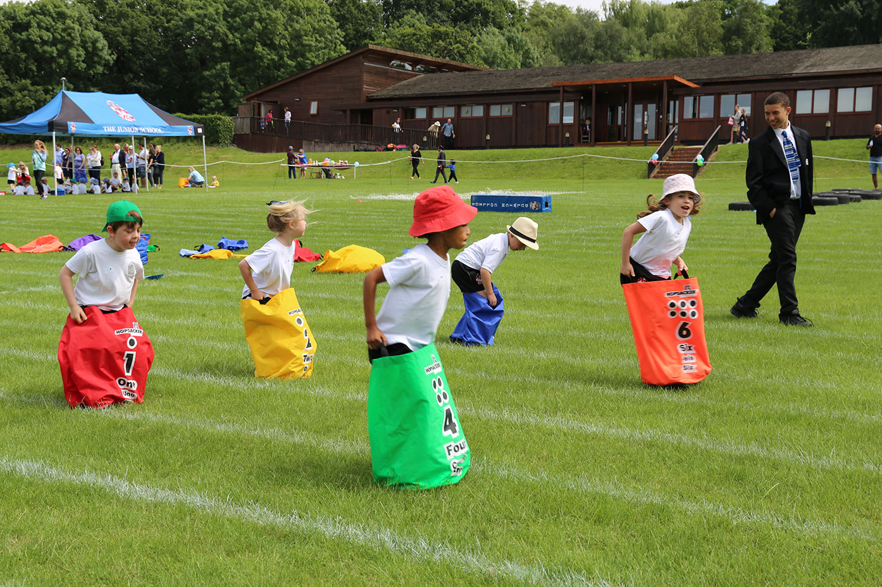
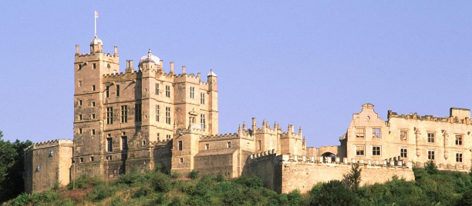


Y1 Important Dates for your diary
15th April – After school Eid event
18th April- 21st April – Easter Bank Holiday weekend
23rd April – Bolsover Castle Visit
Monday 5th May - May Bank Holiday
23rd May – Break up for May Half Term
Monday 9th - Friday 13th June - Y1 Phonics Screening Week
11th June – Sports Day
Wednesday 18th June - Class Photos
2nd July – Inset Day
2nd July – Meet the Teacher (pm)
Wednesday 9th July – Drop-in for families to discuss latest assessments
Friday 18th July - Reports go home
Tuesday 22nd July - Year 6 Leavers' Assembly/School closes for summer break
Wednesday 23rd July – INSET Day/School closes for summer break
End of Year celebration visit to Magna AquaTek – date to be confirmed

