Slide 1
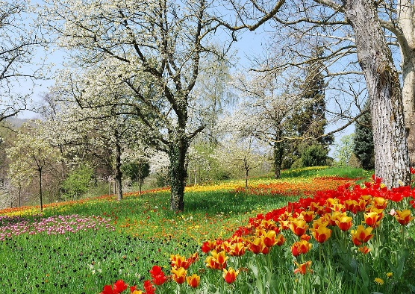




Y3 Important Spring Dates for your diary
Monday 6th January - Back to school
Thursday 9th January - Young Voices
Wednesday 15th January – Y3 Weston Park Museum Visit
Thursday 23rd January - WCMGT Auditions
Thursday 30th January - WCMGT Semi Finals
Tuesday 28th & Wednesday 29th January - Parents' Evening
Friday 14th February - WCMGT Final
Friday 14th February - Finish for half term
Monday 17th February - Friday 21st February Half Term Holiday
Monday 24th February - Spring 2 starts
Wednesday 5th March - World Book Day @ WCM
Wednesday 12th March - INSET 3 school closed for children
Monday 17th & Tuesday 18th March - D&T exhibition in the Hall
Friday 21st March Red Nose Day
Monday 24th - Friday 28th March - Y4 Residential at Thornbridge
Monday 24th - Friday 28th March - Easter Activities, more information to follow
Friday 28th March - Finish for Easter Holidays
Monday 14th April - Summer 1 starts

Slide 2



The main theme for this term is “The Ancient Egyptians”. This is a history topic and we will learn what a civilisation is and also learn more about the achievements of this ancient civilisation.
P.E. Days and Kit
Indoor PE is now on a Tuesday. Outdoor PE is on a Thursday. Children will need to have a PE kit in school for these days. Please ensure your child has a white T-shirt and black shorts, tracksuit bottoms or leggings for these sessions. Now the weather is colder, a jumper for outdoors will be useful. It is also essential that your child has suitable shoes for outdoor PE, such as trainers or pumps. All earrings must be removed at home before PE, or if children can remove them, this can be done in school.
Times Tables and CLIC Gaps
In your child’s journal each week will be their weekly test scores for CLIC and Beat That, as well as their CLIC gap. Can you encourage your child to use the CLIC WAGOLL to revise their CLIC gap? Please do not hesitate to come and speak to an adult if we can offer anymore help.
Children spending ten minutes a day learning their target times tables will find their maths a lot easier, and can get their face on the rocket! We are having some great successes.
Reading and Spellings
Please continue to encourage your child to read, 4 or more a week, and write these in their journal. These will go towards their reading badges each term. They need to do 40 reads to receive their next reading mileage badge. We had some people receiving their badges before Christmas, so would love even more this term!
The weekly spelling lists will be stuck into their journal, ready for their test on a Friday. Please assist them in practising their spellings when you can.

Slide 3







Y3 Spring
The Ancient Egyptian Civilisation
Physical Development
The first half term for indoor PE is practicing yoga, focusing on poses and building our core strength. Outdoor PE will build on those skills, taking these into a range of games. Outdoor PE will be taken by our sports coaches from EVO.
Literacy
In our writing this term we will be using more opportunities to practise writing dialogue. We will also be using our Ancient Egyptian knowledge to write narratives with dialogue and non-chronological reports. We have two new books for guided reading this term, too!
RSHE
In the spring term, children will be thinking about being healthy both mentally and physically. We will discuss our feelings, how listening to them is okay and how we can manage them.
Through lessons teaching about healthy diet, exercise, and the importance of good sleep, the children will think about how to balance all of these things in order to be healthy.
Maths
The first block of learning we have for this term is a unit on length and perimeter, showing understanding of what both are how they can be calculated as well as measuring! We also have a lot of fraction work to do; as well as our daily Big Maths sessions.
Understanding the world
Our topic this term is about the Ancient Egyptians and the amazing achievements they made during that period of history. Within this in-depth study, children will learn in detail about their achievements with building and writing, and how these link to the Ancient Egyptian’s beliefs of the afterlife (eg. why pyramids were constructed). They will also make links between the geography of the country and how and why they lived as they did. This is the children’s first introduction to what civilisation is, and the powers within the country – dynasties led by Pharaohs.
In science, we are thinking about our bodies and how important our skeletons and muscles are; including how we can plan and eat a healthy diet.
Expressive arts and design
We will be working with shape and colour, relating this to the Ancient Egyptians and images they will have seen. This will include using pastels, powder paints and even screen printing!
In Design and Technology we will be looking at designing a healthy breakfast

Slide 4
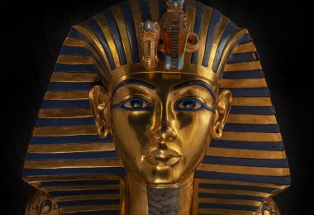
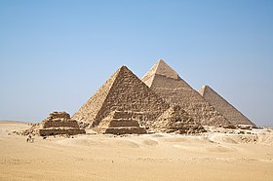
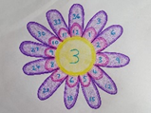


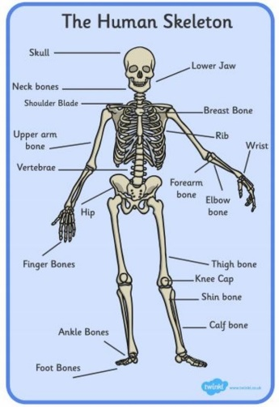
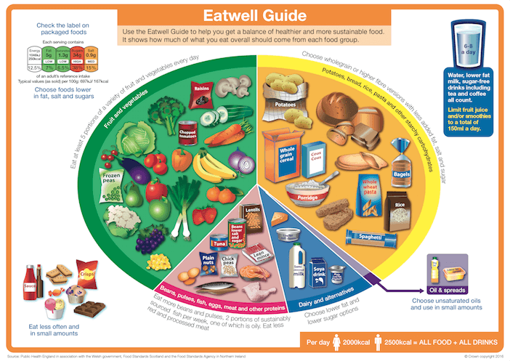
What your child can do to help with their learning
After a term in Y3, you will know that we have an expectation that each child reads at least four times a week. As we have mentioned before, regular reading is proven to show a progression in a child’s vocabulary; and their writing also benefits. Enjoy reading with your child: books, magazines, recipes, game instructions or newspapers all count. Revisit what we talked about in the autumn reading workshop.
Your child can use Times Table Rockstars as a way to practise their times tables, as well as the other methods, such as bingo or dice games. We will be incorporating TTRS into weekly lessons too, as a boost!
https://play.ttrockstars.com/auth
Communication and language
These are some of the key pieces of vocabulary we will encounter during our science topic. Your child could investigate the meanings of these words and make a glossary with the words and the explanations.
Pharaoh, sphinx, pyramid, mummification, the Nile river, commonalities, chronology, civilisation, timeline,
Hieroglyphics, settlements, river valleys
diet, nutrition, healthy, fruit, vegetables, fibre,
carbohydrates, protein, dairy, fats, sugar, salt
Thank you for your support and please send any learning or enquiries to y3@watercliffe.sheffield.sch.uk

