Slide 1
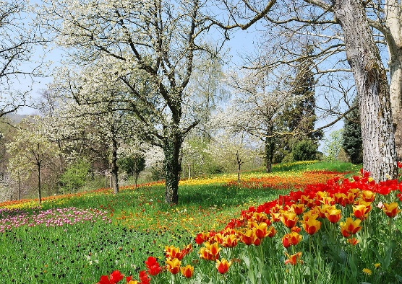




Y4 Important Spring Dates for your diary
Monday 6th January - Back to school
Thursday 9th January - Young Voices
Thursday 23rd January - WCMGT Auditions
Tuesday 28th & Wednesday 29th January - Parents' Evenings
Thursday 30th January - WCMGT Semi Finals
Friday 14th February - WCMGT Final
Friday 14th February - Finish for half term
Monday 16th February - Friday 21st February - Half Term Holiday
Monday 24th February - Spring 2 starts
Wednesday 5th March - World Book Day @ WCM
Tuesday 12th March - D&T exhibition in the Hall
Wednesday 12th March - INSET 3/5 school closed for children
Monday 17th and Tuesday 18th March – Design and Technology Exhibition
Friday 21st March – Red Nose Day
Monday 24th – Wednesday 26th March – Y4MB @ Thornbridge
Wednesday 26th – Friday 28th March – Y4GH @ Thornbridge
Week beginning 24th March - Easter Activities, more information to follow
Friday 28th March - Finish for Easter Holidays
Monday 31st March – Friday 11th April – Easter Holidays
Monday 14th April - Summer 1 starts

Slide 2



The main theme for this term is Volcanoes and Earthquakes. This is a new geography topic.
P.E. Days and Kit
Indoor PE is still on a Tuesday. Outdoor PE is on a Thursday. Children will need to have a PE kit in school for these days. Please ensure your child has a white T-shirt and black shorts, tracksuit bottoms or leggings for these sessions. Now the weather is colder, a jumper for outdoors will be useful. It is also essential that your child has suitable shoes for outdoor PE, such as trainers or pumps. All earrings must be removed at home before PE. Any child with earrings in will not be allowed to get into the pool at swimming.
Reading and Spellings
Please continue to encourage your child to read, 4 or more a week, and write these in their journal. These will go towards their reading badges each term. They need to do 40 reads to receive their next reading mileage badge. We had some people receiving their badges before Christmas, so would love even more this term!
The weekly spelling lists will be stuck into their journal, ready for their test on a Friday. Please assist them in practising their spellings when you can.
Times Tables and CLIC Gaps
In your child’s journal each week will be their weekly test scores for CLIC and Beat That, as well as their CLIC gap. Can you encourage your child to use the CLIC WAGOLL to revise their CLIC gap? Please do not hesitate to come and speak to an adult if we can offer anymore help.
Children spending ten minutes a day learning their target times tables will find their maths a lot easier, and can get their face on the rocket! We are having some great successes. The national times table test will be at the end of this term.

Slide 3







Y4 Spring
Volcanoes and Earthquakes
Physical Development
Our outdoor sessions will continue to be a varied set of sessions with EVO. Indoor sessions will start off gymnastics and then switch to swimming for the rest of the year. We will let you know more details nearer the time.
Literacy
We will be watching, and writing, about a short film called Feast. After this, we will be writing a non-chronological report about habitats. After half term, we will follow this up with a piece a non-fiction text.
We have two new books for guided reading this term, too!
RSHE
Building on all our previous RSHE lessons, the year four spring learning is around how we treat those around us. We will reflect on the differences and similarities between boys and girls and the assumptions that can be made here and how we can fight stereotypes.
Understanding the World
Our topic this term is a geography topic about volcanoes and earthquakes. Alongside looking at atlases, the globe and other maps so we can learn more about the physical geography of the world, we are also going to learn more about volcanoes and earthquakes. This involves how they happen, where they are found and what effect they can have.
In science, children will learn to identify that a circuit needs to be a complete loop with a cell and that some materials conduct electricity.
Maths
The first block of learning we have for this term is a unit on multiplication and division; this includes learning formal written methods for multiplying and dividing. Length and perimeter and Fractions and decimals.
Expressive Arts and Design
We will continue our clarinet sessions until early February. Children will use their sketch books to record their observations and use them to review and revisit ideas to help improve their mastery of art and design techniques: including drawing, painting and sculpture with a range of materials. They will also learn about great artists, architects and designers in history.

Slide 4

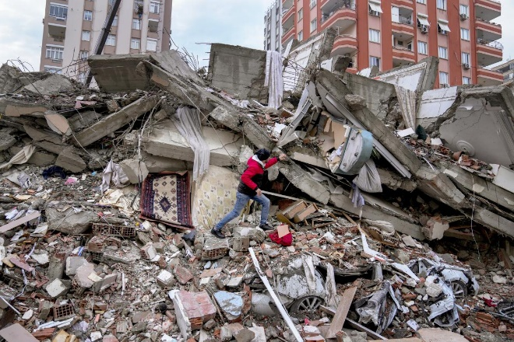
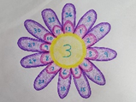


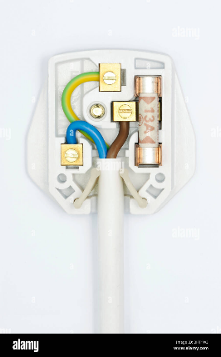
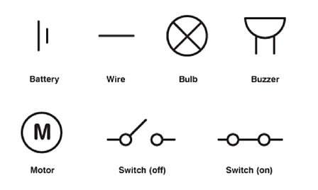
What your child can do to help with their learning
After a term in Y4, you will know that we have an expectation that each child reads at least four times a week. As we have mentioned before, regular reading is proven to show a progression in a child’s vocabulary; and their writing also benefits. Enjoy reading with your child: books, magazines, recipes, game instructions or newspapers all count.
Your child can use Times Table Rockstars as a way to practise their times tables, as well as the other methods, such as bingo or dice games. We will be incorporating TTRS into weekly lessons too, as a boost! Please remember that children will take the National Times Table test at the end of this term.
https://play.ttrockstars.com/auth
Communication and Language
These are some of the key pieces of vocabulary we will encounter during our science topic. Your child could investigate the meanings of these words and make a glossary with the words and the explanations.
electricity, circuit, battery, bulb, motor, buzzer, wire,
crocodile clips, switch, conductor, insulator
Thank you for your support and please send any learning or enquiries to y4@watercliffe.sheffield.sch.uk

