Slide 1







Welcome to F1 - Autumn 1 – We are Family!
Physical Development
In our PE sessions we will develop our fundamental movement skills through the topic of 'all about me'. Fundamental skills will include balancing, running, changing direction, jumping, hopping and travelling. We will be finding out which is our dominant hand for holding a pencil and be making marks such as lines and circles or even letters from our name.
Literacy
In our stories for talking sessions we will be reading the story ‘The Washing Line’ and carrying out different activities related to the story based at a 1, 2 or 3 key word level. We will begin our mark making by drawing a picture of ourselves and attempting to write our name.
Personal, Social and Emotional Development
We will welcome our new children into nursery and help them to settle in, make friends and have lots of fun!
We will explore our emotions using the book ‘The Colour Monster’
In our circle times we will find out about our new children, what they like to play with, who is in their family, their favourite food, TV shows and things they do at home.
We will find out about the celebration of Eid and compare it to the celebration of Christmas, talking about any similarities and differences.
Understanding the world
We will begin the half term by talking about the adventures we had over the summer holidays with our families.
We will read stories about different families and talk about our families and how they are the same or different in terms of family members. We will compare ourselves to our friends looking at our hair, eyes, skin colour and other features deciding whether we are the same and different.
We will begin to find out about our local area Shirecliffe by walking down to Tesco in small groups to do some shopping for nursery.
Maths
In our Little Big Maths sessions, we will be subitising (this is fast recognition of objects without counting) up to 3 objects. We will learn ‘enough’, ‘bigger’ and ‘smaller’. In the construction area we will build houses, shops and other recognisable landmarks from our local area.
Expressive arts and design
We will paint, collage, draw and create our faces using loose parts. We will learn different songs related to ourselves which we will perform to our parents for our big finish at the end of the half term.

Slide 2

How to help your child this half term
Point out print in the environment for example bus stop sign, stop sign and supermarket names to help your child with early reading skills.
Practise subitising with your child- quickly spotting different groups of amounts without counting them. Start with noticing 1 and 2 objects e.g. 2 socks, 1 teddy, 2 cars, 1 ball. When your children are able to subitise 1 and 2 quickly you can move onto subitising 3 objects.
Key vocabulary
Some of our key words will be-
Growing, older, taller, bigger, baby, crawl, milk, bottle.
Family member names
Same/ different
Body parts, face features and skin tones to describe similarities and differences.
Positional words- in, on, under, next to, behind, in front.
Map, route, road, roundabout, up, down, corner, turn.
Stories for talking vocabulary- socks, dress, pants, jumper, scarf, trousers, coat, t-shirt, hat, shorts, wet, dry, wearing, washing, drying, hanging, splashing.
Our selfie home learning this half term will be for you to send us a photo of your child finding different shop logos or familiar buildings from our local area of Shirecliffe.
Thank you for your support and please send any photos or enquiries to f1@watercliffe.sheffield.sch.uk

Slide 3
Key Dates for the half term
Monday 2nd September- Training Day 1. School closed to children.
Tuesday 3rd September- Open day for new children to look around nursery and meet teachers.
Wednesday 4th September- Nursery open for children.
Wednesday 25th September- Individual school Photos.
Tuesday 8th and Wednesday 9th October- Parent’s Evening.
Wednesday 23rd October- Spooky Dress Up day.
Friday 25th October- Break up for Half Term.

Slide 4
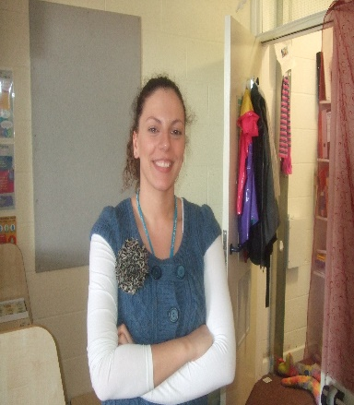

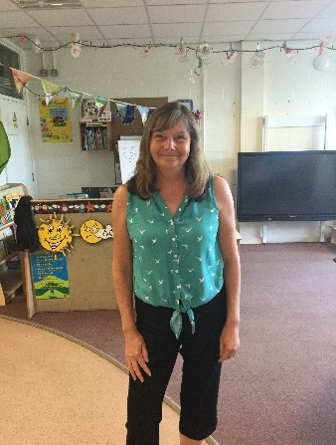

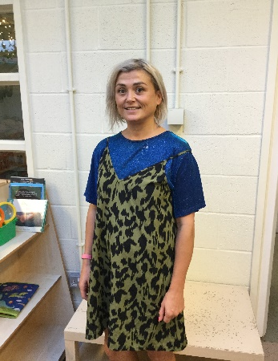
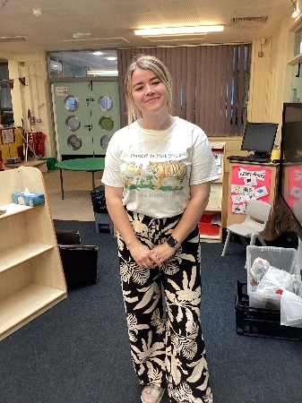
Danielle Houghton
Teacher
Jodie Moxam HLTA
Danielle Page
Teaching Assistant
Diane
Fenton
Teaching Assistant
Lisa Howson
Teaching Assistant
Khloe Squires
Student Teacher
Meet the F1 Team

