Slide 1

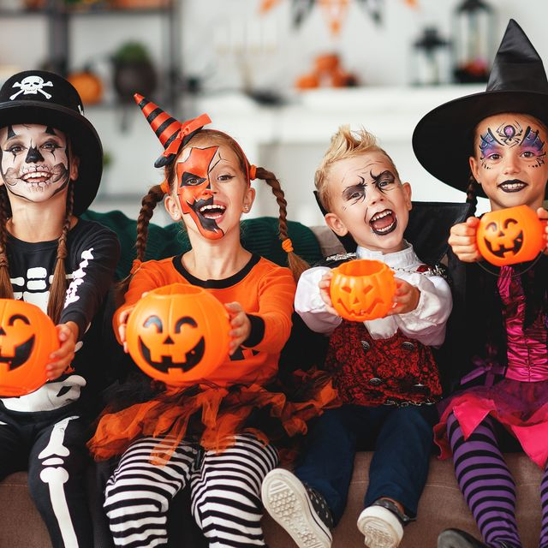
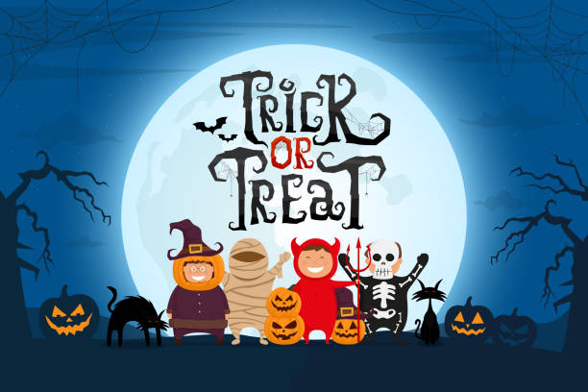


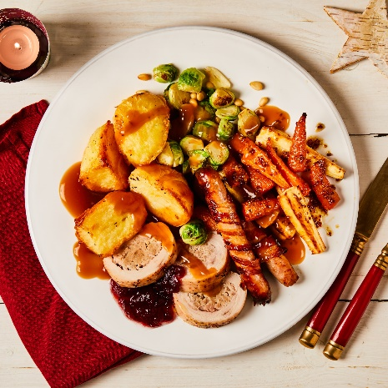

Y4 Important Dates for your diary
Monday 2nd September - Training Day 1 School closed to children
Tuesday 3rd September - Children back at school
Wednesday 25th September - Individual Photos
Wednesday 2nd October – Y4 Murton Park Visit
Friday 4th October - Flu Vaccinations
Tuesday 8th & Wednesday 9th October - Parents Evenings
Friday 25th October - Spooky Dress Up Day & Cosy Read
Friday 25th October - Break up
Monday 4th November - Children back at school
Wednesday 27th November - Training Day 2 School closed to children
Monday 2nd December - Step into Christmas parent craft event
Wednesday 4th December - Christmas Fayre
Wednesday 18th December - Christmas Dinner & Cosy Read
Friday 20th December - Break Up
Monday 6th January - Spring Term starts

Slide 2



The main themes for this term are historical and children learn about ‘settlement’, ‘power’ and ‘invasion’. The children will look at the early settlers in Britain – the Picts, Scots, Anglo Saxons and Vikings – and their contest for power. They learn about what invasion is, and the reasons behind it, some were more successful than others! We will also be visiting Murton Park to become Anglo-Saxons.
P.E. Days and Kit
Our PE days are to be confirmed, but we will let you know shortly. Children will need to have a PE kit in school for these days. Please ensure your child has a white T-shirt and black shorts, tracksuit bottoms or leggings for these sessions. It is also essential that your child has suitable shoes for outdoor PE, such as trainers or pumps. All earrings must be removed at home before PE.
Times Tables and CLIC Gaps
In your child’s journal each week will be their weekly test scores for CLIC and Beat That, as well as their CLIC gap. Can you encourage your child to use the CLIC WAGOLL to revise their CLIC gap? Please do not hesitate to come and speak to an adult if we can offer anymore help.
Children spending ten minutes a day learning their target times tables will find their maths a lot easier, and can get their face on the rocket!
Reading and Spellings
Please can you make sure your child has their journal in school every day and get them, or yourself, to write in their reads. These will go towards their reading badges each term. They need to do 40 reads to receive their next reading mileage badge.
The weekly spelling lists will be stuck into their journal, ready for their test on a Friday. Please assist them in practising their spellings when you can.

Slide 3



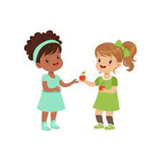



Welcome to Y4 - Autumn
How have the Anglo Saxons and Vikings shaped our country today?
Physical Development
We will have two PE sessions each week, one based indoors and one outdoors. These session will build on children’s individual skills, as well as working as a team. They will be taught within mini-tasks and lots of games.
Literacy
In our writing we will be writing about an animation called Blue Umbrella. We will also write a report around what life was like as an Anglo-Saxon, linking to our history visit to Murton Park. This will lead onto us writing a newspaper report about a famous Viking raid on Lindisfarne. We will then be comparing two ‘similar’ books: The Wild Robot and The Iron Man.
Relationships and Health Education
In our weekly circle times and other lessons, one of the things we are exploring are friendships. We will be looking at what makes a good friend and how classmates and members of the community are connected, as well as what makes us different.
During our annual anti-bullying week ‘ Choose Respect’, we will be building on our learning about online safety. The children will learn about where we can get news from in a digital sense, and how easy it is for us to get a restricted view of reported information.
Understanding the world
We are learning about the Anglo Saxons and Vikings this term. We will begin by looking at why the Anglo Saxons came to Britain and why they stayed. During our visit to Murton Park, we will learn about village life and spend the day as a Saxon.
In the second half term, we will find out about Viking raids and how they invaded Britain. We learn about long ships and what made the Vikings such excellent seafarers.
Maths
Place value is our main block of the first half term: we will also cover addition & subtraction. For the rest of the term, we will look at the first area of our multiplication and division block. In addition to this, we will have multiple Big Maths sessions every week.
Expressive arts and design
In Design and Technology, we will be creating shell structures to make boxes. We will also have weekly music sessions from the Sheffield Music Hub, where we will build on our recorder skills from Y3, and begin to learn the clarinet.

Slide 4
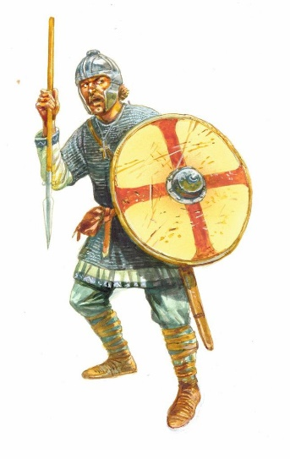
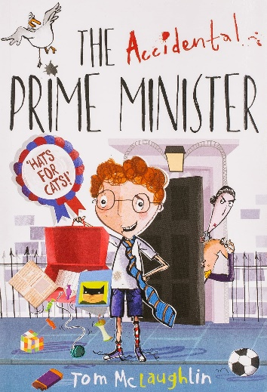



What your child can do to help with their learning
As you will know from last term, we have an expectation that each child reads at least four times a week. Regular reading is proven to show a progression in a child’s vocabulary; and their writing also benefits. Enjoy reading with your child: books, magazines, recipes, game instructions or newspapers!
Your child can use Times Table Rockstars as a way to practise their times tables, as well as the other methods sent home last term, such as bingo or dice games.
https://play.ttrockstars.com/auth
These are some of the key pieces of vocabulary we will encounter during our history topic. Your child could investigate the meanings of these words and make a glossary with the words and the explanations.
border Danelaw settlement invasion settlement
trader conquer fierce warrior defend
long ship emigrate long house
Thank you for your support and please send any learning or enquiries to y4@watercliffe.sheffield.sch.uk

