Slide 1




Monday 17th April - Summer 1 starts
Monday 1st May - May Day bank holiday school closed
Monday 8th May - King Charles Coronation Day school closed
Friday 12th May – Visit from Gill Furniss MP to the Y4 children
Friday 26th May - Finish for half term
Monday 29th May - Friday 2nd June - Half term holiday
Monday 5th June - Summer 2 starts
W/C Monday 5th June – national multiplication checks for Y4 children
Tuesday 13th June pm - Y3/4 Sports Day
Week Beginning 26th June - Y5/6 Play week
Tuesday 4th July - Richard O'Neil Author in school
Tuesday 4th July - Parent's Evening 3.30-5.00
Wednesday 5th July - Parent's Evening 2.30-6.00
Wednesday 5th July - INSET 5/5 school closed for children
Friday 14th July - Reports out to families
Tuesday 18th July pm - WCM Carnival
Friday 21st July - Finish for the summer holidays
P.E. Days and Kit
Up until the 4th May, Mr Baines’ class will continue swimming on a Tuesday am. From the 11th May, Mr Bebbington’s will have the swimming sessions. Indoor PE (if your class isn’t swimming, they will do their PE session on the Tuesday after Social Time). Outdoor PE will be on a Thursday afternoon. Children will need to have a PE kit in school for these days. Please ensure your child has a white T-shirt and black shorts, tracksuit bottoms or leggings for these sessions.
In summer 2, we will be doing street dance with Dance Daze on a Monday afternoon. This will replace indoor PE for Mr Baines’ class and outdoor PE for Mr Bebbington’s class.
Reading and Spellings
Please can you make sure your child has their journal in school every day and get them, or yourself, to write in their reads. These will go towards their reading badges each term. They need to do 40 reading to receive their next reading mileage badge.
The weekly spelling lists will be stuck into their journal, ready for their test on a Friday. Please assist them in practising their spellings when you can.
Times Tables and CLIC Gaps
Weekly CLIC and Beat That test scores and a CLIC gap will be recorded in journals each week. Can you encourage your child to use the CLIC WAGOLL to revise their CLIC gap. Please do not hesitate to come and speak to an adult if we can offer anymore help.
Children spending ten minutes a day learning their times tables will find their maths a lot easier, and can get their face on the rocket!

Slide 2



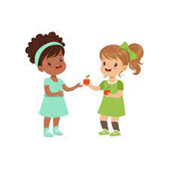



Welcome to Y4 - Summer – How does our environment shape how we live?
Physical Development
Our outdoor PE sessions are athletics skills: running, jumping, throwing etc. During our indoor sessions we are doing swimming and dance.
Literacy
Our two Write Stuff units this term are ‘The Great Chocoplot’ and ‘Float’. Linking to our theme, the children will learn more about David Attenborough to write a biography.
We are beginning a new class book for guided reading, Podkin One Ear and will enjoy reading and answering questions about the book.
Relationships and Health Education
In our weekly circle times and other lessons, one of the things we are exploring are friendships. We will be looking at what makes a good friend and how classmates and members of the community are connected, as well as what makes us different.
Understanding the world
Geography is the main subject for this term, thinking about our environment and learning lots of skills. Your child will be building on their skills of using maps to find and learn about places in the local area: Busk Meadow Park and Parkwood Springs. To extend our learning we will think about the human impact on the environment and what we could do to lessen it.
In science, through investigations and lessons the children will learn about living things and their habitats, linking to our geography and some of our writing.
Maths
Geometry is one of the main blocks of maths we are doing this term: properties of shape and position and direction. Our other blocks are time, further work on decimals, statistics and the life-skill of money.
There will be multiple Big Maths sessions each week.
Expressive arts and design
We will have weekly art and gardening sessions with two visiting artists. We will also have weekly music sessions from the Sheffield Music Hub, where we will continue to learn the recorder.

Slide 3




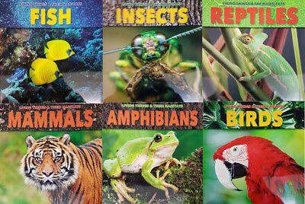

What your child can do to help with their learning
As you will know from last term, we have an expectation that each child reads at least four times a week. Regular reading is proven to show a progression in a child’s vocabulary; and their writing also benefits. Enjoy reading with your child: books, magazines, recipes, game instructions or newspapers!
Your child can use Times Table Rockstars as a way to practise their times tables, as well as the other methods sent home last term, such as bingo or dice games. During this term, the children will have a multiplication check (that is a national expectation) in the two-week period from 5th June.
https://play.ttrockstars.com/auth
Communication and language
These are some of the key pieces of vocabulary we will encounter during our science topic. Your child could investigate the meanings of these words and make a glossary with the words and the explanations.
habitat microhabitat mini-beasts vertebrates invertebrates
Mammals birds fish reptiles amphibians
molluscs annelids echinoderms arachnids insects
Thank you for your support and please send any enquiries to y4@watercliffe.sheffield.sch.uk

